Slide 1

DnD Dice Counter
Eric Horng
ECE4179 – Neural Networks

Slide 2
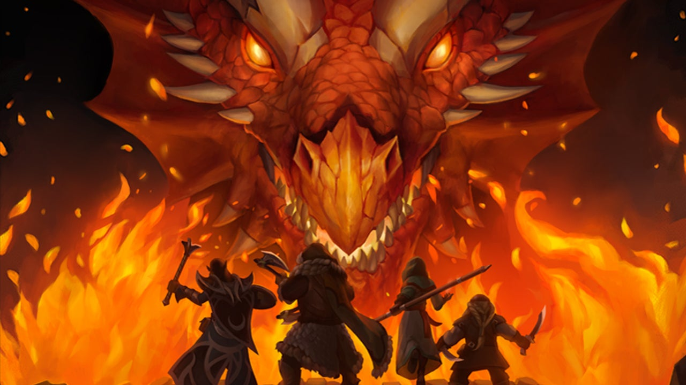
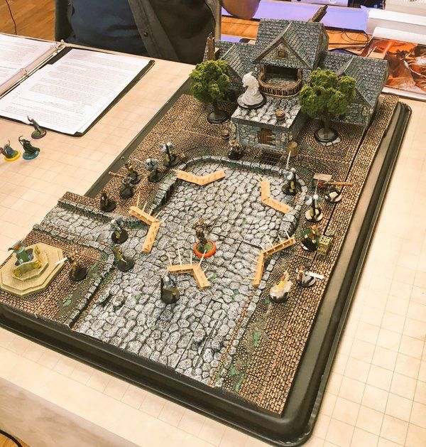
Dungeons and Dragons

Slide 3
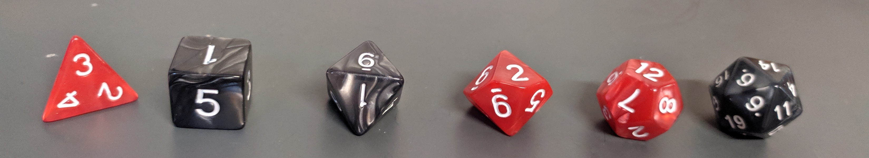
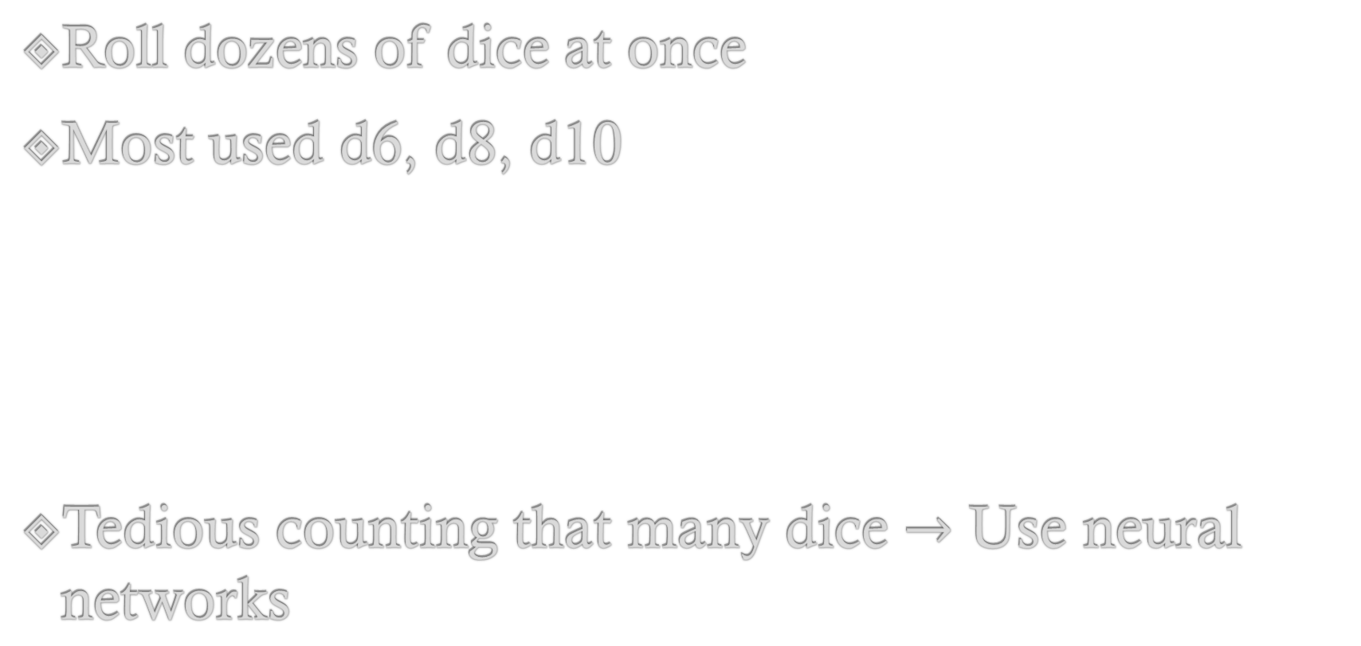
DnD - Dice Rolling
Roll dozens of dice at once
Most used d6, d8, d10
Tedious counting that many dice $→$ Use neural networks

Slide 4
Goals
Detect top face of dice
Classify detected face
Sum up classes and display

Slide 5
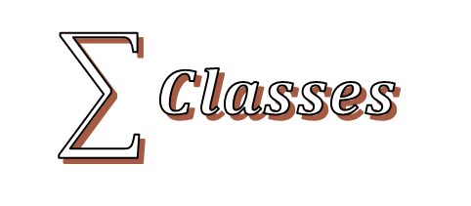
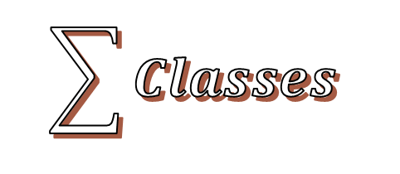
Image
Image
YOLOv3
Specialized
Object Detector
General
Cropped Face, 1 class
1,2,3,...,12
Resnet101
Specialized
$$\sum{Classes}$$
12 Classes
$$\sum{Classes}$$

Slide 6
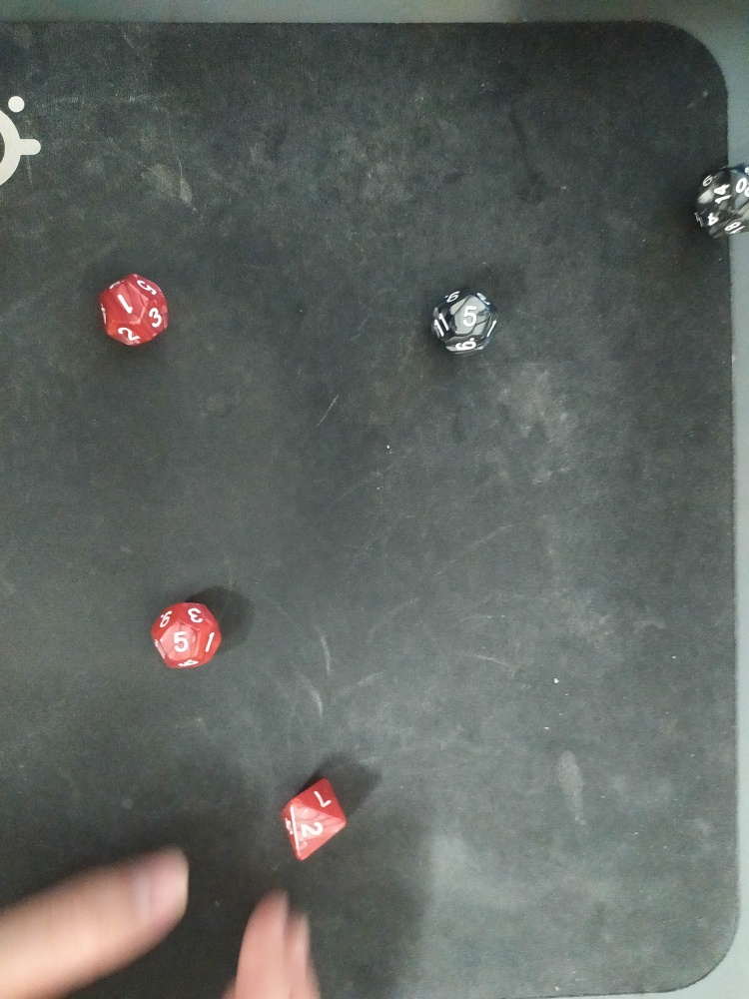
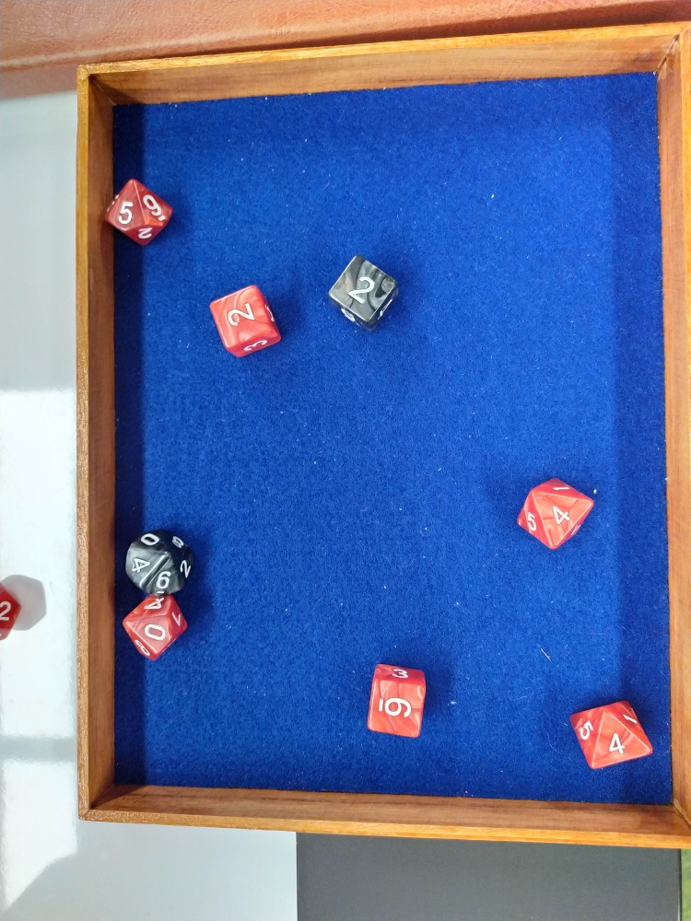
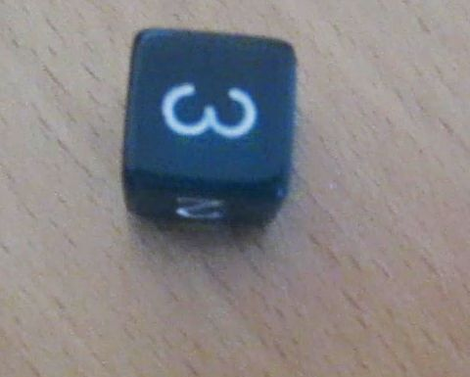
Data
Dice Dataset + Phone pictures
Around 850 images

Slide 7
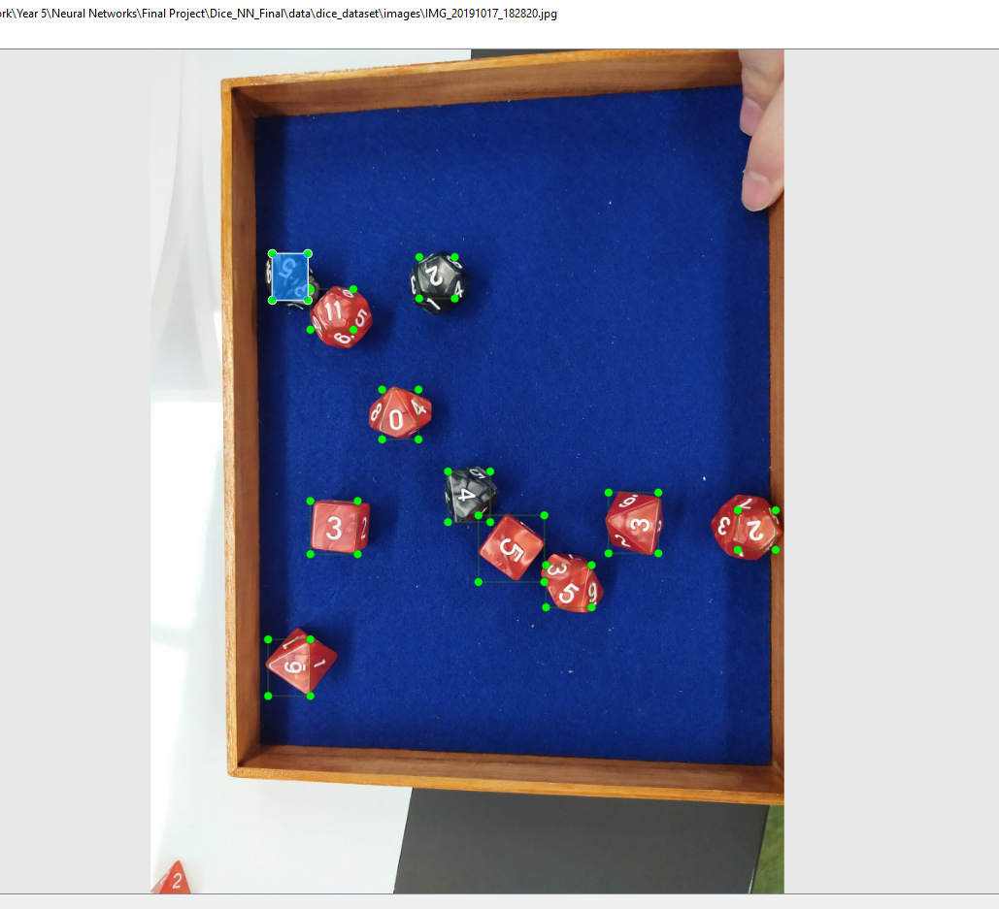
Labels
Box coordinates – x , y , box width, box height

Slide 8
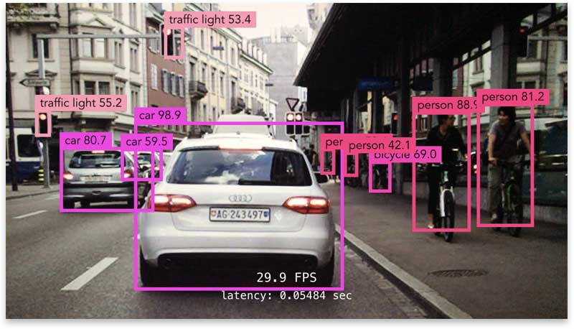
Object Detection

Slide 9
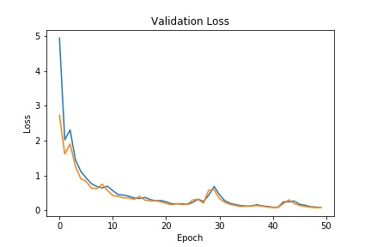
YOLOv3
Google Colab
Around 3 min per epoch
50 epochs
lr = 0.006
Batch Size = 16
lr decreased by 1/10

Slide 10
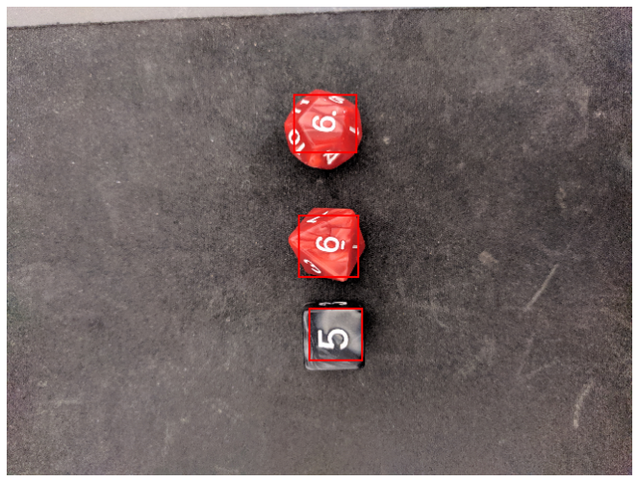
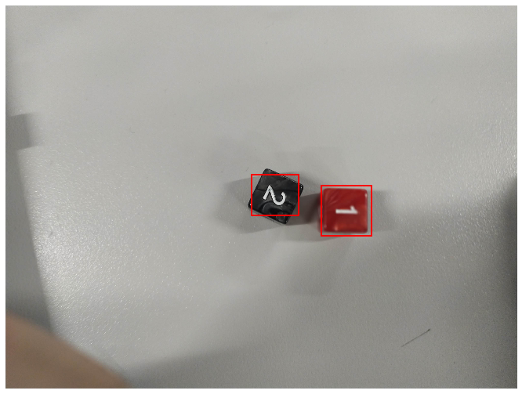
Object Detection Results

Slide 11
Classifier

Slide 12
Resnet101 Transfer Learning
Faster convergence
Better accuracy

Slide 13
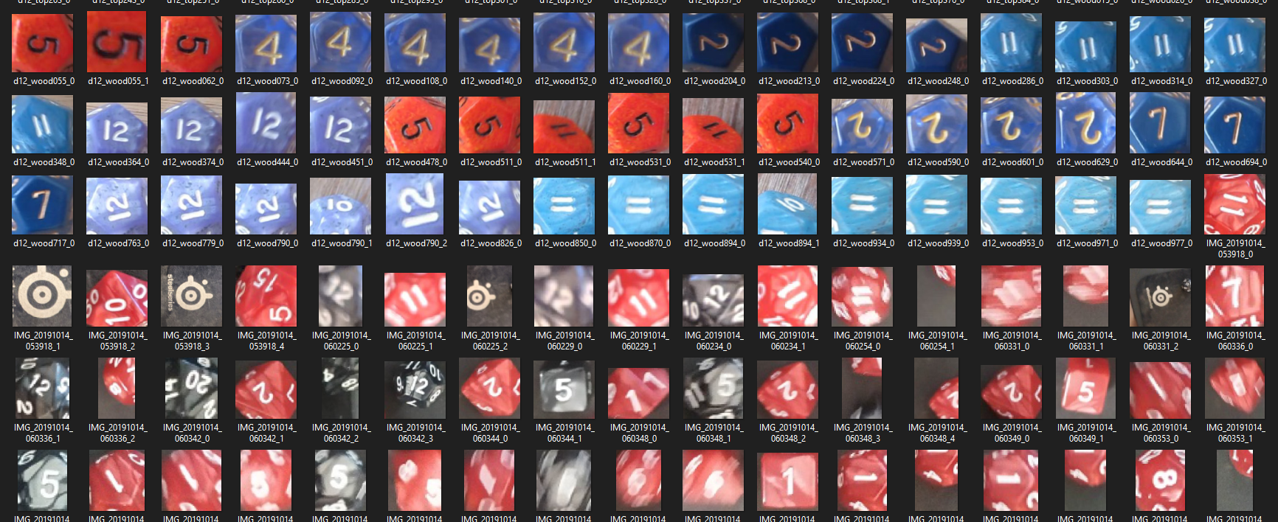
Classifier Data
Run dataset through object detection
Manually sort into folders (2000 images)
H/V Flips, Random Rotation, Normalization

Slide 14
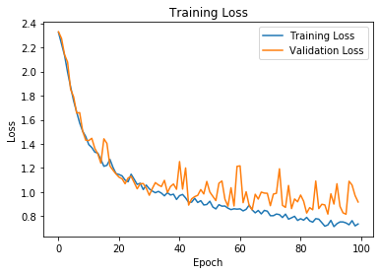
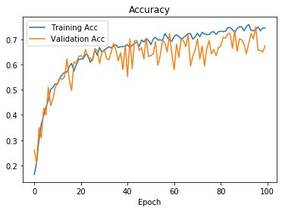
Classifier Training
lr = 0.001
100 epochs
Validation set ~ 100 images
Max validation accuracy = 75%
Adam, CrossEntropyLoss

Slide 15
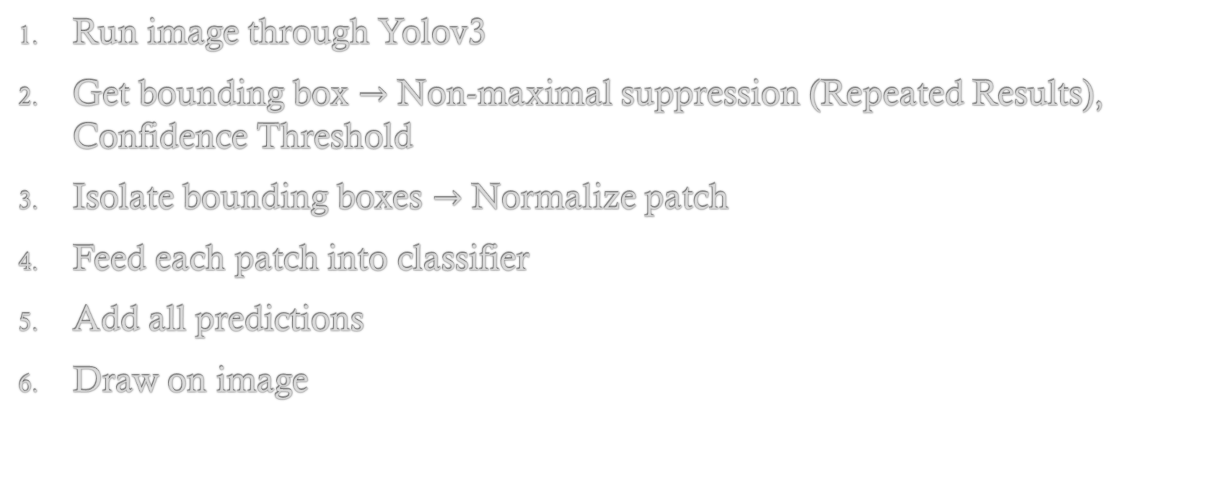
Program Flow
Run image through Yolov3
Get bounding box $→$ Non-maximal suppression (Repeated Results), Confidence Threshold
Isolate bounding boxes $→$ Normalize patch
Feed each patch into classifier
Add all predictions
Draw on image

Slide 16
Final Results

Slide 17
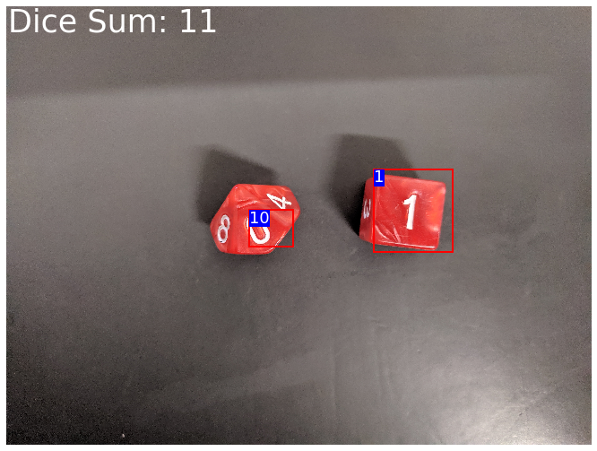
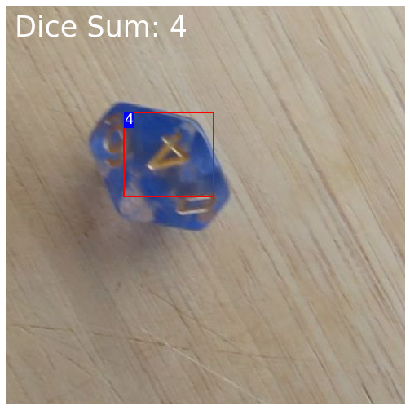
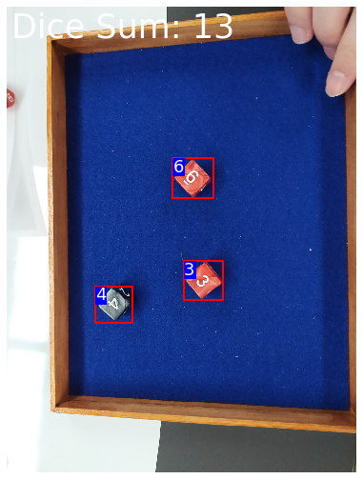
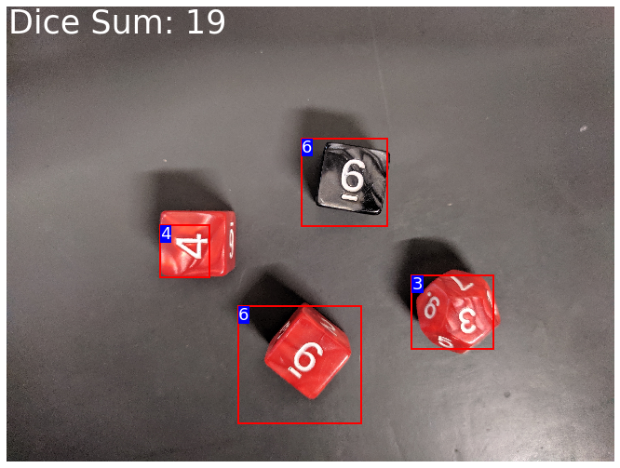
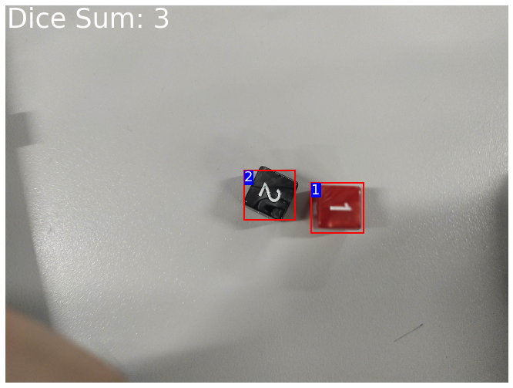
The Good

Slide 18
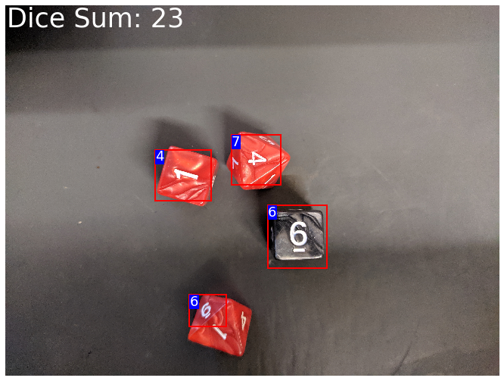
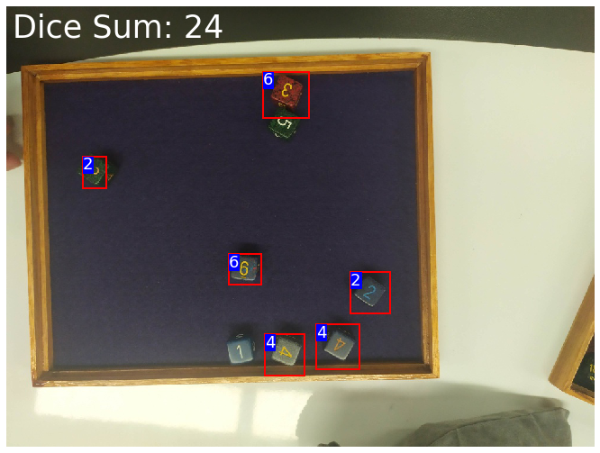

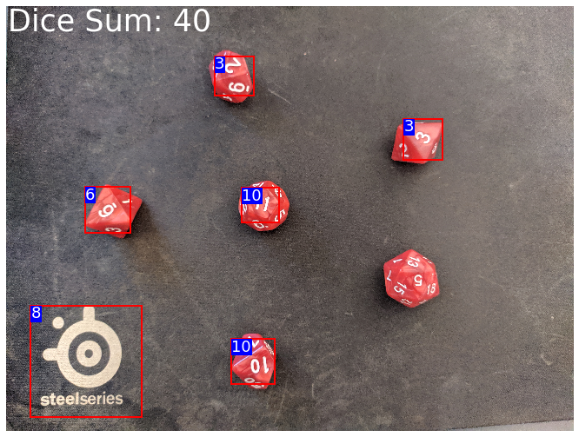
The Bad

Slide 19
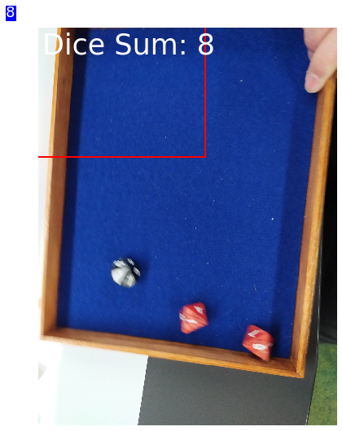
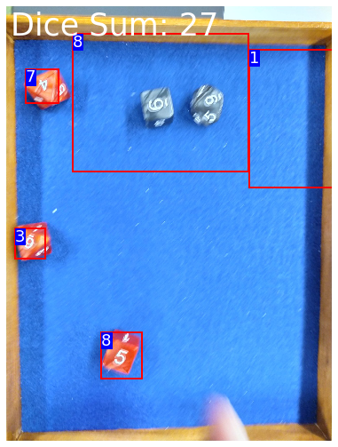
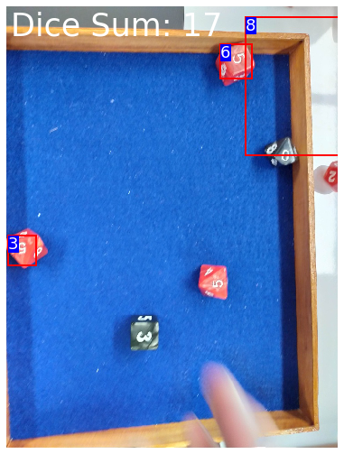
The Ugly

Slide 20
Performance
Classifies empty spaces, misses dice
Works great on singular dice
More dice = bigger chance of misclassification
Works best with d6 (only one face visible)
Worst with d12 (less data)
Zoomed = Better

Slide 21
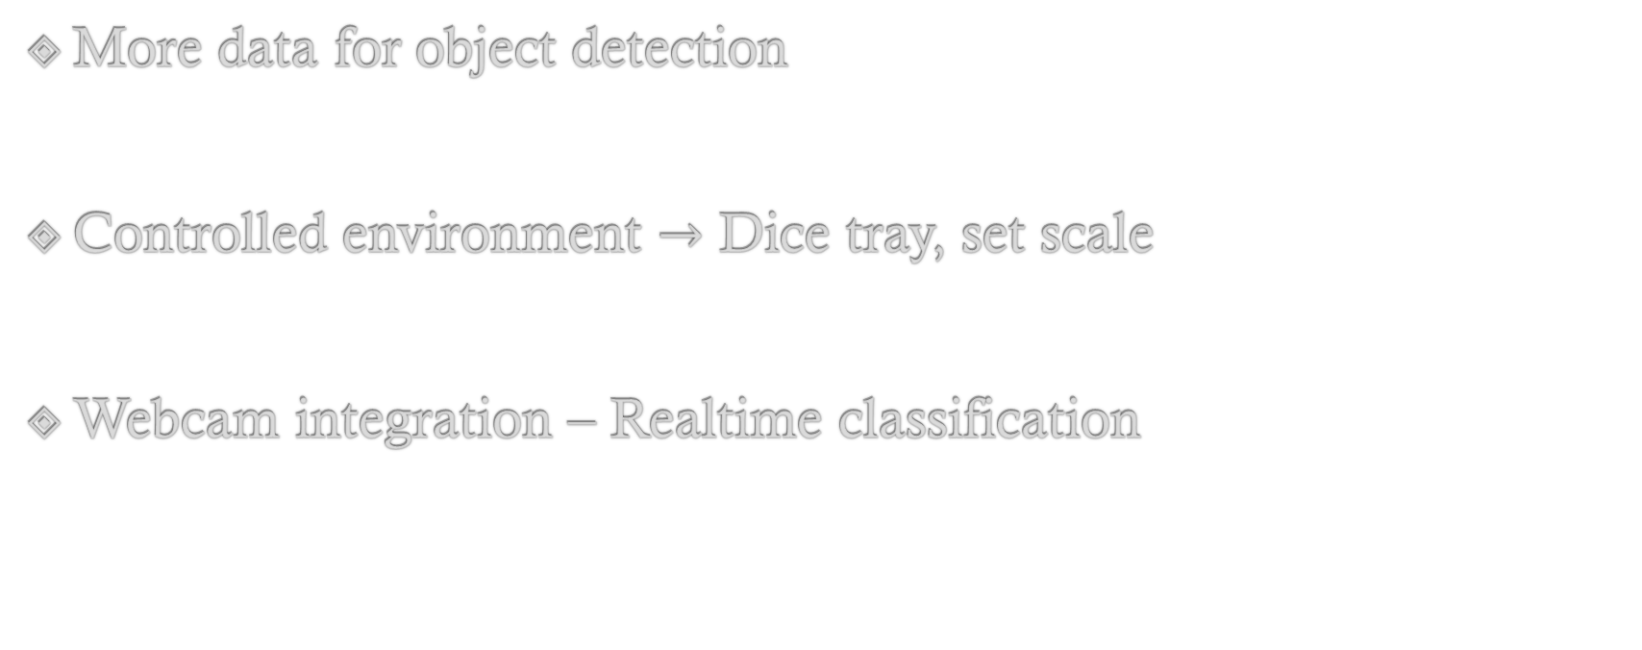
Improvements
More data for object detection
Controlled environment $→$ Dice tray, set scale
Webcam integration – Realtime classification

Slide 22
Questions

Slide 23
Thanks for listening

